Slide 1
Chapter 10: Stratification and Social Class
By: Ariel Waters

Slide 2
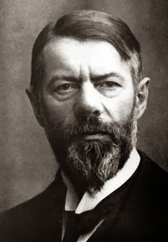
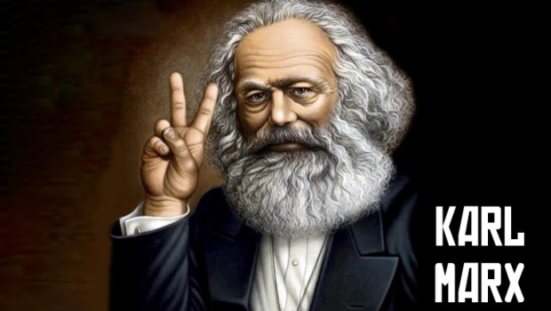
Two Influential Socialist
Karl Marx and Max Weber

Slide 3
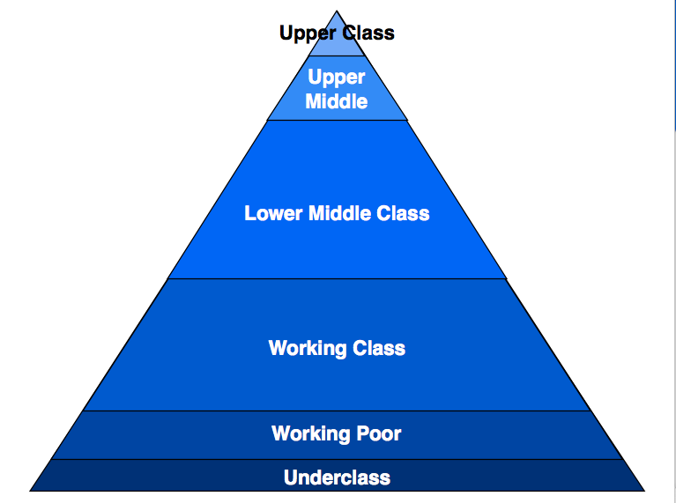
Social Stratification
“The hierarchical ranking with a society of various social class groups according to wealth, power and prestige” (Macionis, 2017).

Slide 4
Social Class Distinctions:
Upper Class
Contains 1 to 3 percent of the total population; old vs new money-mutigenerational or inherited wealth vs first generation, self-earned wealth
Middle Class
Contains 40 to 50 percent of the total population; less than half are upper middle class income ranging from 100,000 to about 200,000 annually; the other portion earn an income of 50,000 to 90,000 annually
Working Class
Contains one third of society earning 30,000 to 50,000 annually
Lower Class
Contains 20 percent of population and is comprised of poor whites, and other racial and ethnic groups

Slide 5

Measurable Indicators of Social Stratification:
INCOME DISTRIBUTION
WEALTH
POVERTY

Slide 6
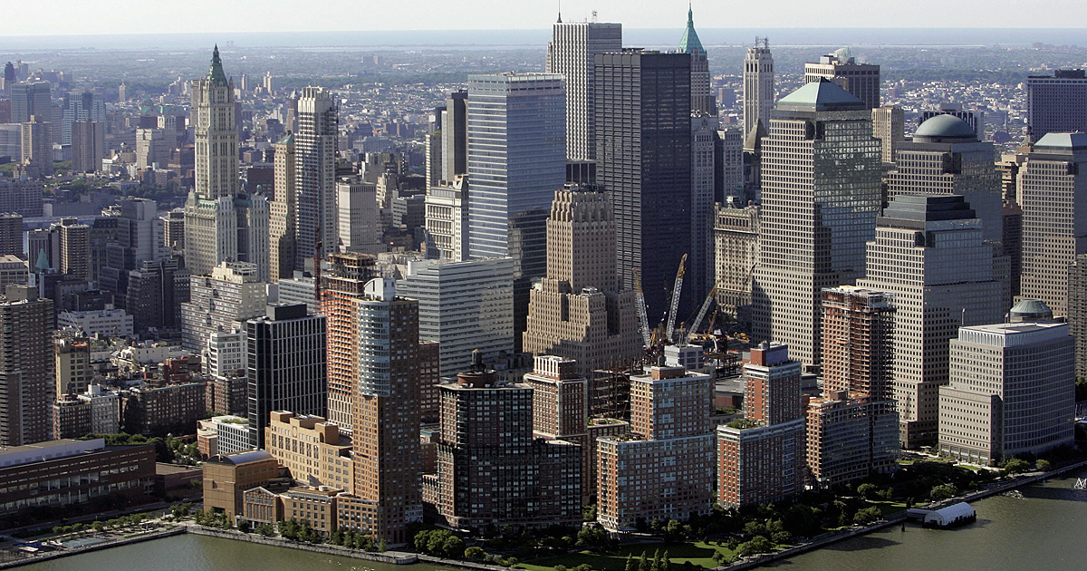
Incomes Within and Outside Cities
“When comparing income data by residence, it was found that in metropolitan areas, those living outside central cities are better off than those living with central cities” (Macionis, 2017).

Slide 7
Wealth and Net Worth
Wealth- “refers to either marketable assets, such as real estate and other property, bank accounts, and stocks, bonds, and other securities. Financial assets (all of the preceding minus owner-occupied housing)” (Macionis, 2017).
Net Worth- “refers to all of one’s assets minus all liabilities (what one owes)” (Macionis, 2017).
Net worth is a more accurate indicator of economic well-being.

Slide 8
Poverty Nationwide
“In 2013, the poverty threshold for a U.S. family of four was $27,376” (Macionis, 2017).

Slide 9
Poverty Within and Outside Cities
“In 2013, more U.S. city residents- 19.1 percent, nearly one in five-lived in poverty compared with those living outside central cities, where the poverty rate was 11.1 percent (one in nine)” (Macionis, 2017).
“In non-metropolitan areas, 16.1 percent (about on in six) lived in poverty. In absolute numbers, this translated to about 19.9 million in central cities, 18.1 million outside central cities, and 8.5 million in non-metropolitan areas” (Macionis, 2017).

Slide 10
Urban Social Class Diversity
Upper-Class Urban Neighborhoods-This class have several homes and alternate where they live at different times of the year.
Middle-Class Urban Neighborhoods-Has changed from 1970s from industrial to service sector, made up of well-paying, professional positions that brought young (late 20s to early 40s, urban professional (yuppies) usually single or married with or without children, Dinks (dual income, no kids) young professional couples without children. Made up of African American college graduates entering the labor market aka (buppies) a new group of black urban professionals.
Working-Class Urban Neighborhoods-most of these neighborhoods gemenischaft community, with shared values, intimacy, a strong sense of belonging, and a strong support network. Aka urban villages.
Mixed-Income Urban Neighborhoods-Keys to quality of life in this neighborhood are household income levels and the desire and ability of residents to remain there.
Low-Income Urban Neighborhoods-usually high population density and substandard housing are most often located near the central business district, they came to be inner-city neighborhoods as well as ghettos or slums. These “truly disadvantaged” are poor people who rely on welfare assistance and the underground economy in order to survive
The Homeless- is a complex, no stereotype gives a complete picture of the homeless. Efforts to revitalize cities with new construction on the edges of the central business districts or downtowns destroyed many of the old single-room occupancy hotels that once provided housing to people living on the edge of poverty.

Slide 11
Suburban Social Class Diversity
Upper-Income Suburbs-“Resemble old aristocratic ones of yesteryear. Families have large houses on large properties with swimming pools and center their social lives on churches or temples and exclusive country clubs”(Macionis, 2017).
Middle-Income Suburbs-Life centers on family and child centered activities. Parents raise their children in a place of socioeconomic homogeneity, away from what they see as the evils of the city.
Working-Class Suburbs-In early twentieth century as home for both factories and their workers. Then moved to become blue collar workers with the opportunity to live in their own homes and work nearby.
Suburban Cosmopolitan Centers-composed of academics, professionals, writers, actors, artists, and students, these communities resemble the university areas, bohemian enclaves, and cosmopolite residential neighborhoods of central cities.
Minority Suburbs-The rise in black suburbanization rests on the group’s increasing percentage of college graduates and their economic progress.

Slide 12
The End
Reference:
Macionis, J. J. (2017). Cities and urban life . Pearson .

Slide 13
Who were the two influential socialists in the creation of social stratification?
Karl Marx and Max Weber
What are three measurable indicators of social stratification?
Income Distribution
Wealth
Poverty

